Slide 1
WEB-READ
Presented by :-
Karthik Reddy- 1601-19-737-039 IT-1(2/4)
Mohammed Fawwazuddin- 1601-19-737-041 IT-1(2/4)

Slide 2
TABLE OF CONTENTS
01
02
03
About Our Project
Aim & Introduction
Requirements & Sneak-Peek
04
Features & Conclusion

Slide 3
ABOUT OUR PROJECT
→ A platform designed for Writers & Readers to share and peruse the data inventory.

Slide 4
AIM & INTRODUCTION
A website for Writers & Readers.
Ease of use and navigation.
A Hub and Spoke Model.
Beautiful Interface with built-in features.
Opens the possibilities to share and read at the convenience.

Slide 5
REQUIREMENTS
OPERATING SYSTEMS
→ Supports both Mobile and PC operating systems.
HARDWARE REQUIREMENTS
→ Suitable processing speed for faster results.
SOFTWARE REQUIREMENTS
→ FRONT-END :- HTML, CSS, JS
→ Database for data inventory.
→ Web-browser with suitable ethernet and bandwidth connection.

Slide 6

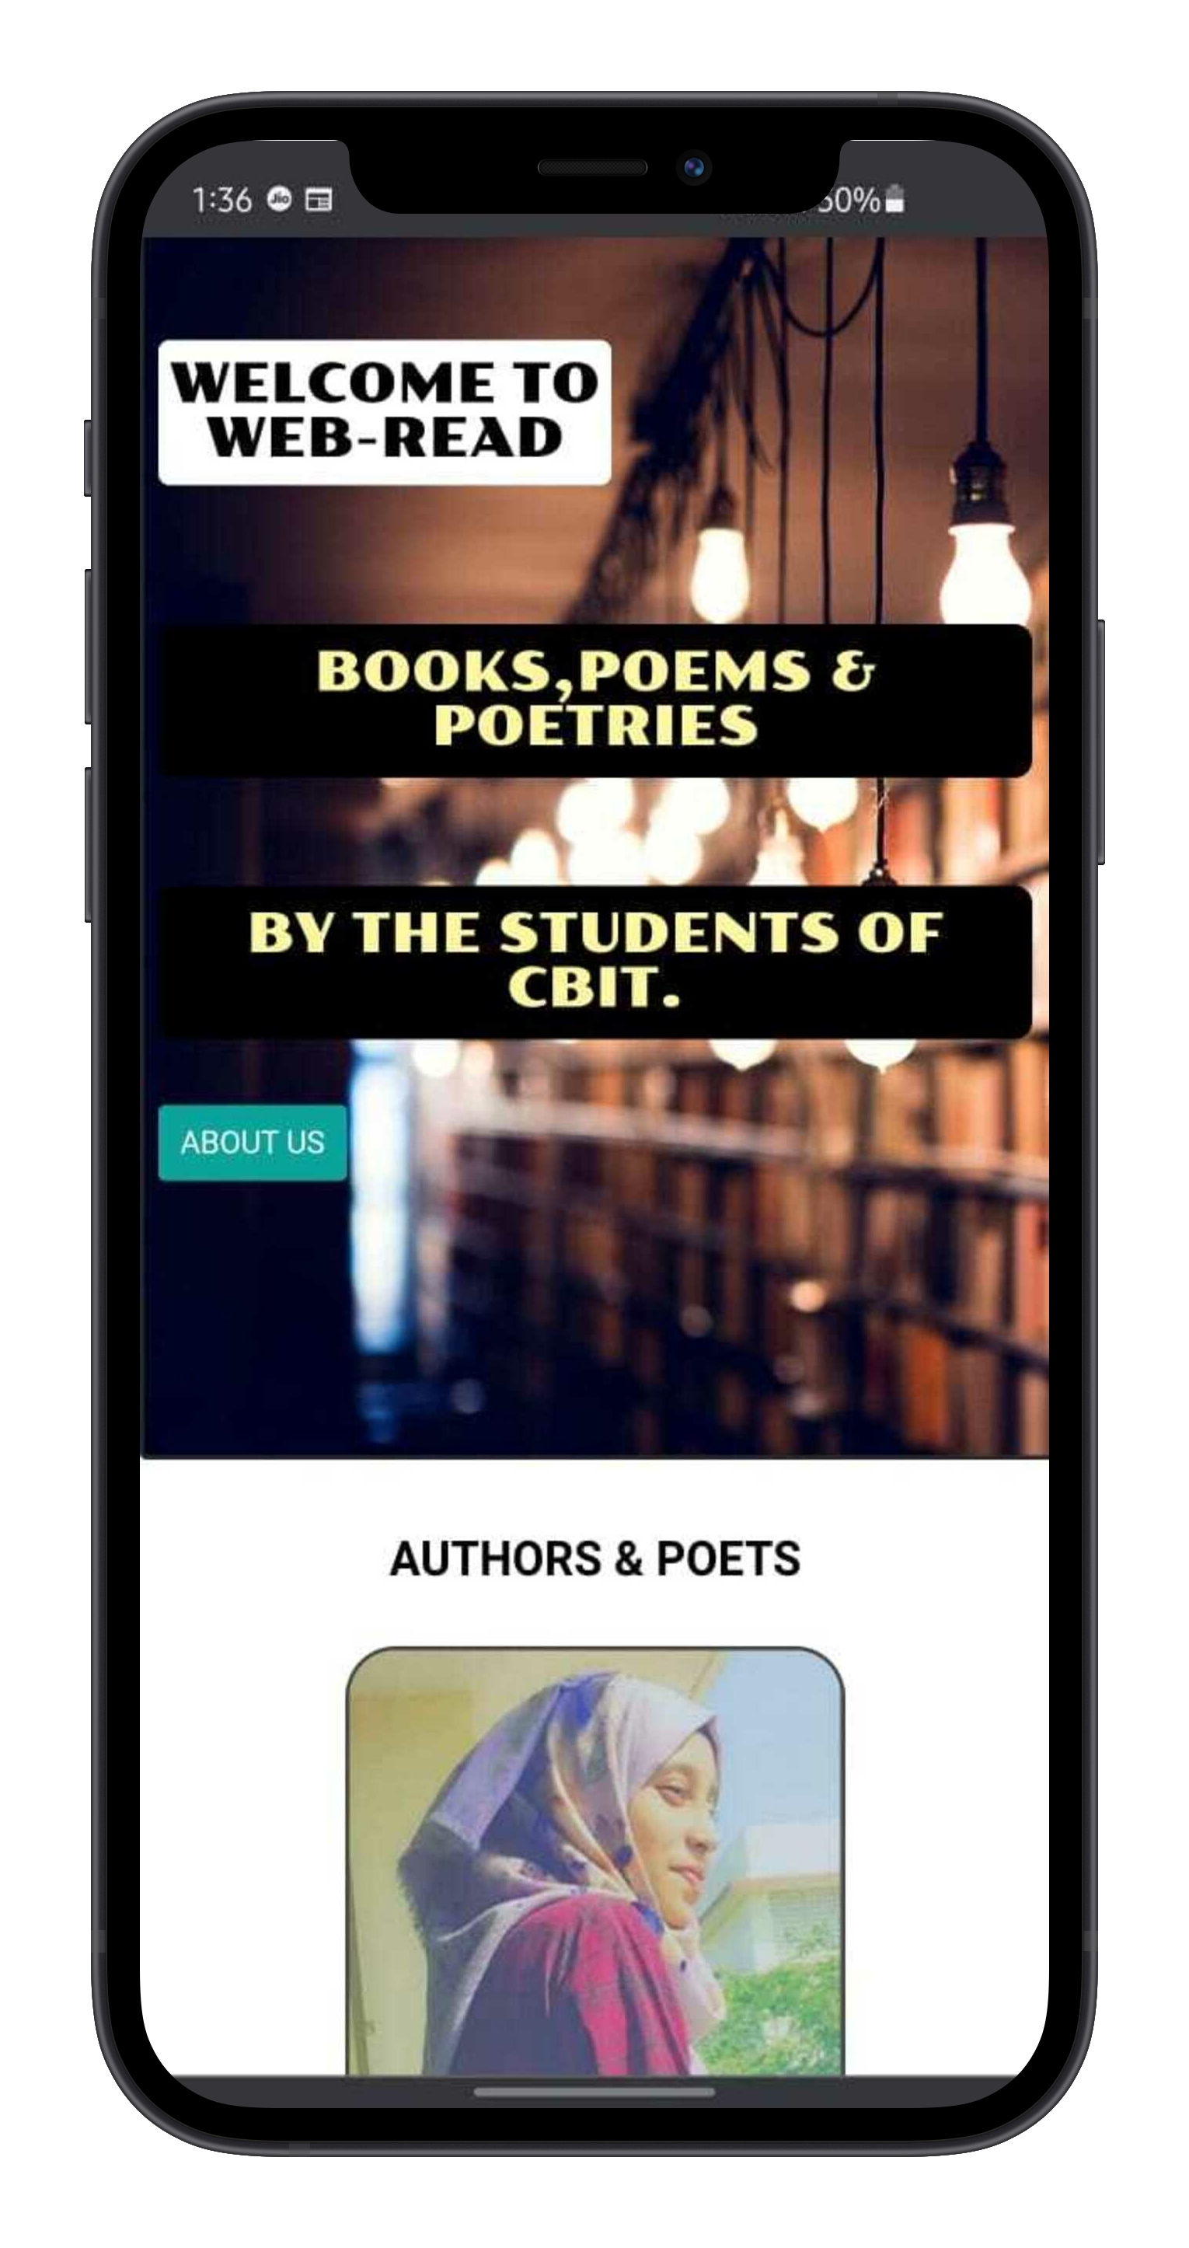
HOME PAGE
Credits :- MockUPhone

Slide 8
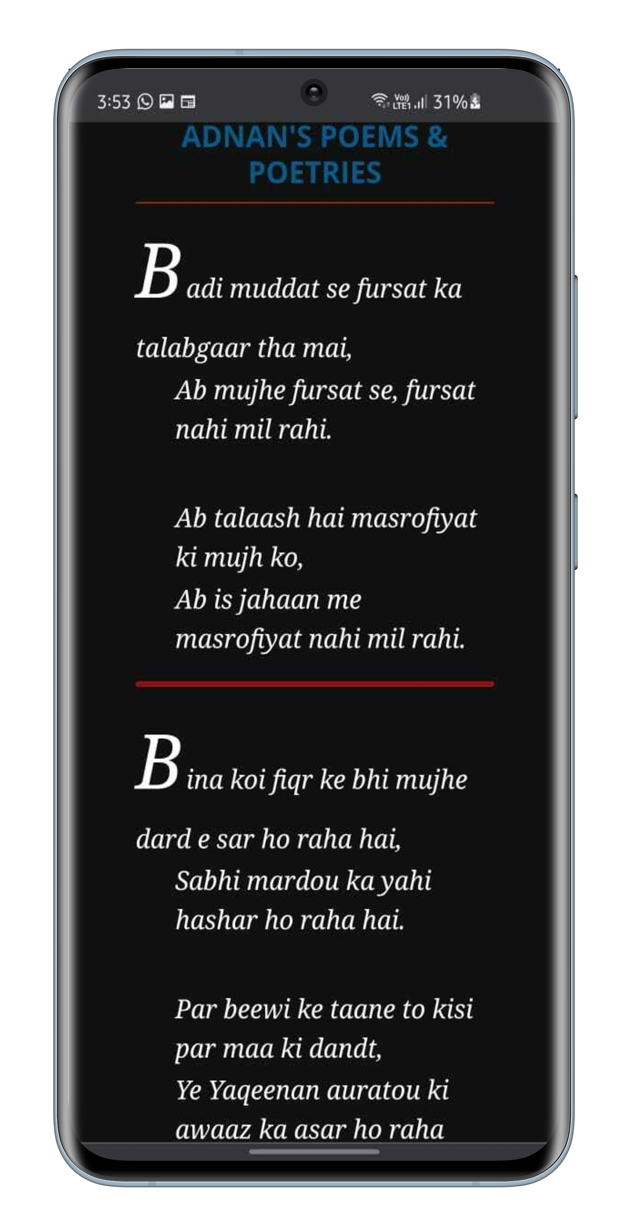
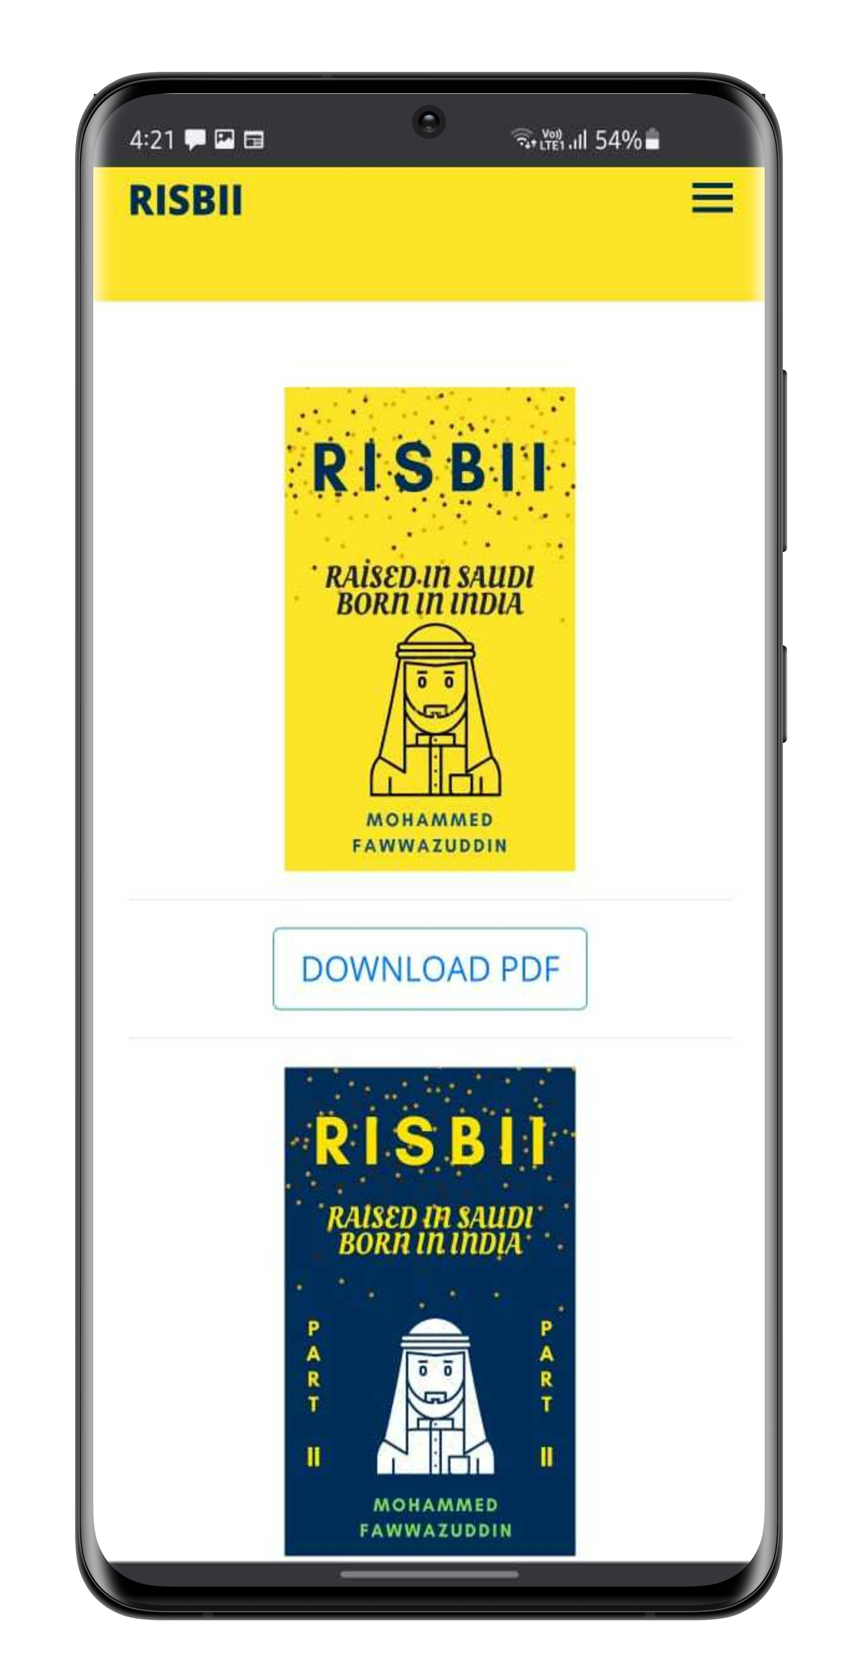
Credits :- MockUPhone

Slide 9
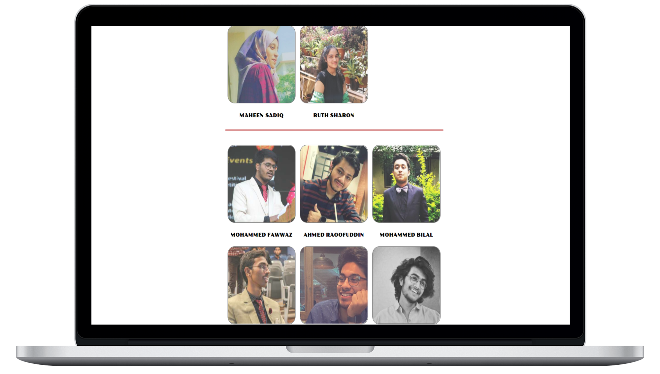
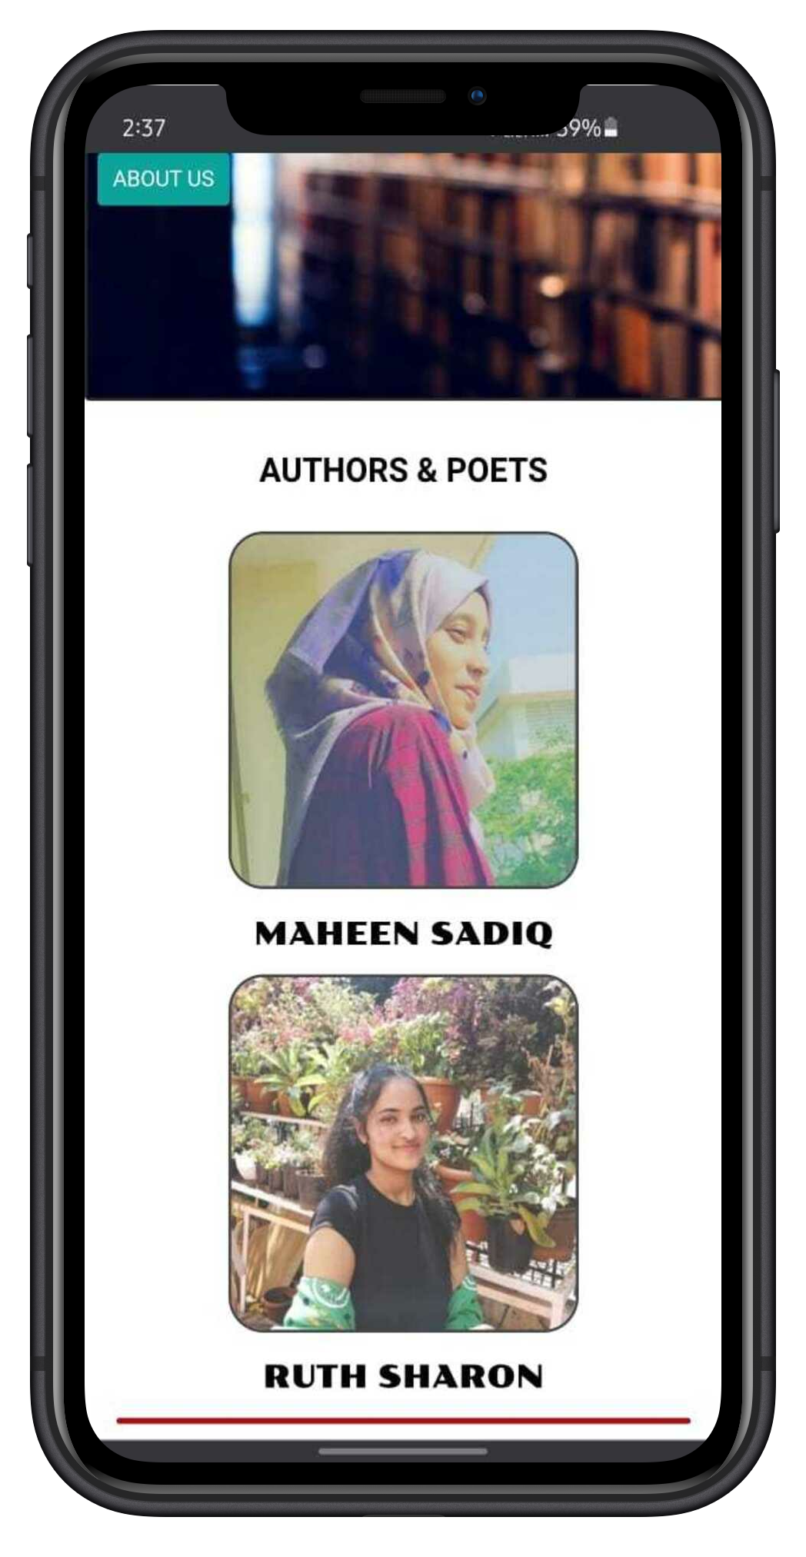
HOME PAGE

Slide 10
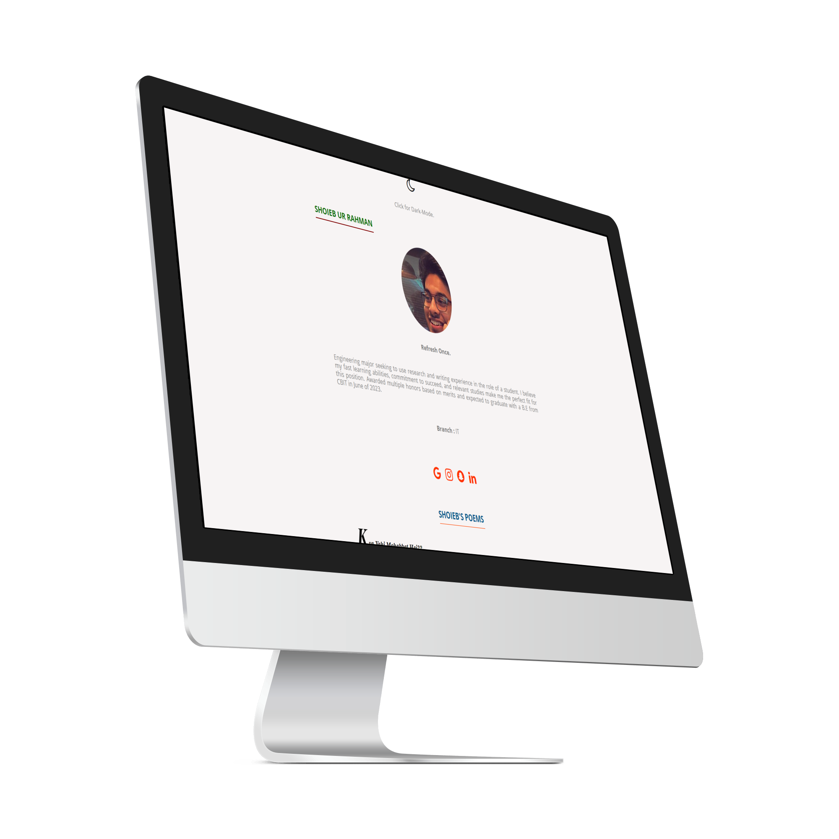
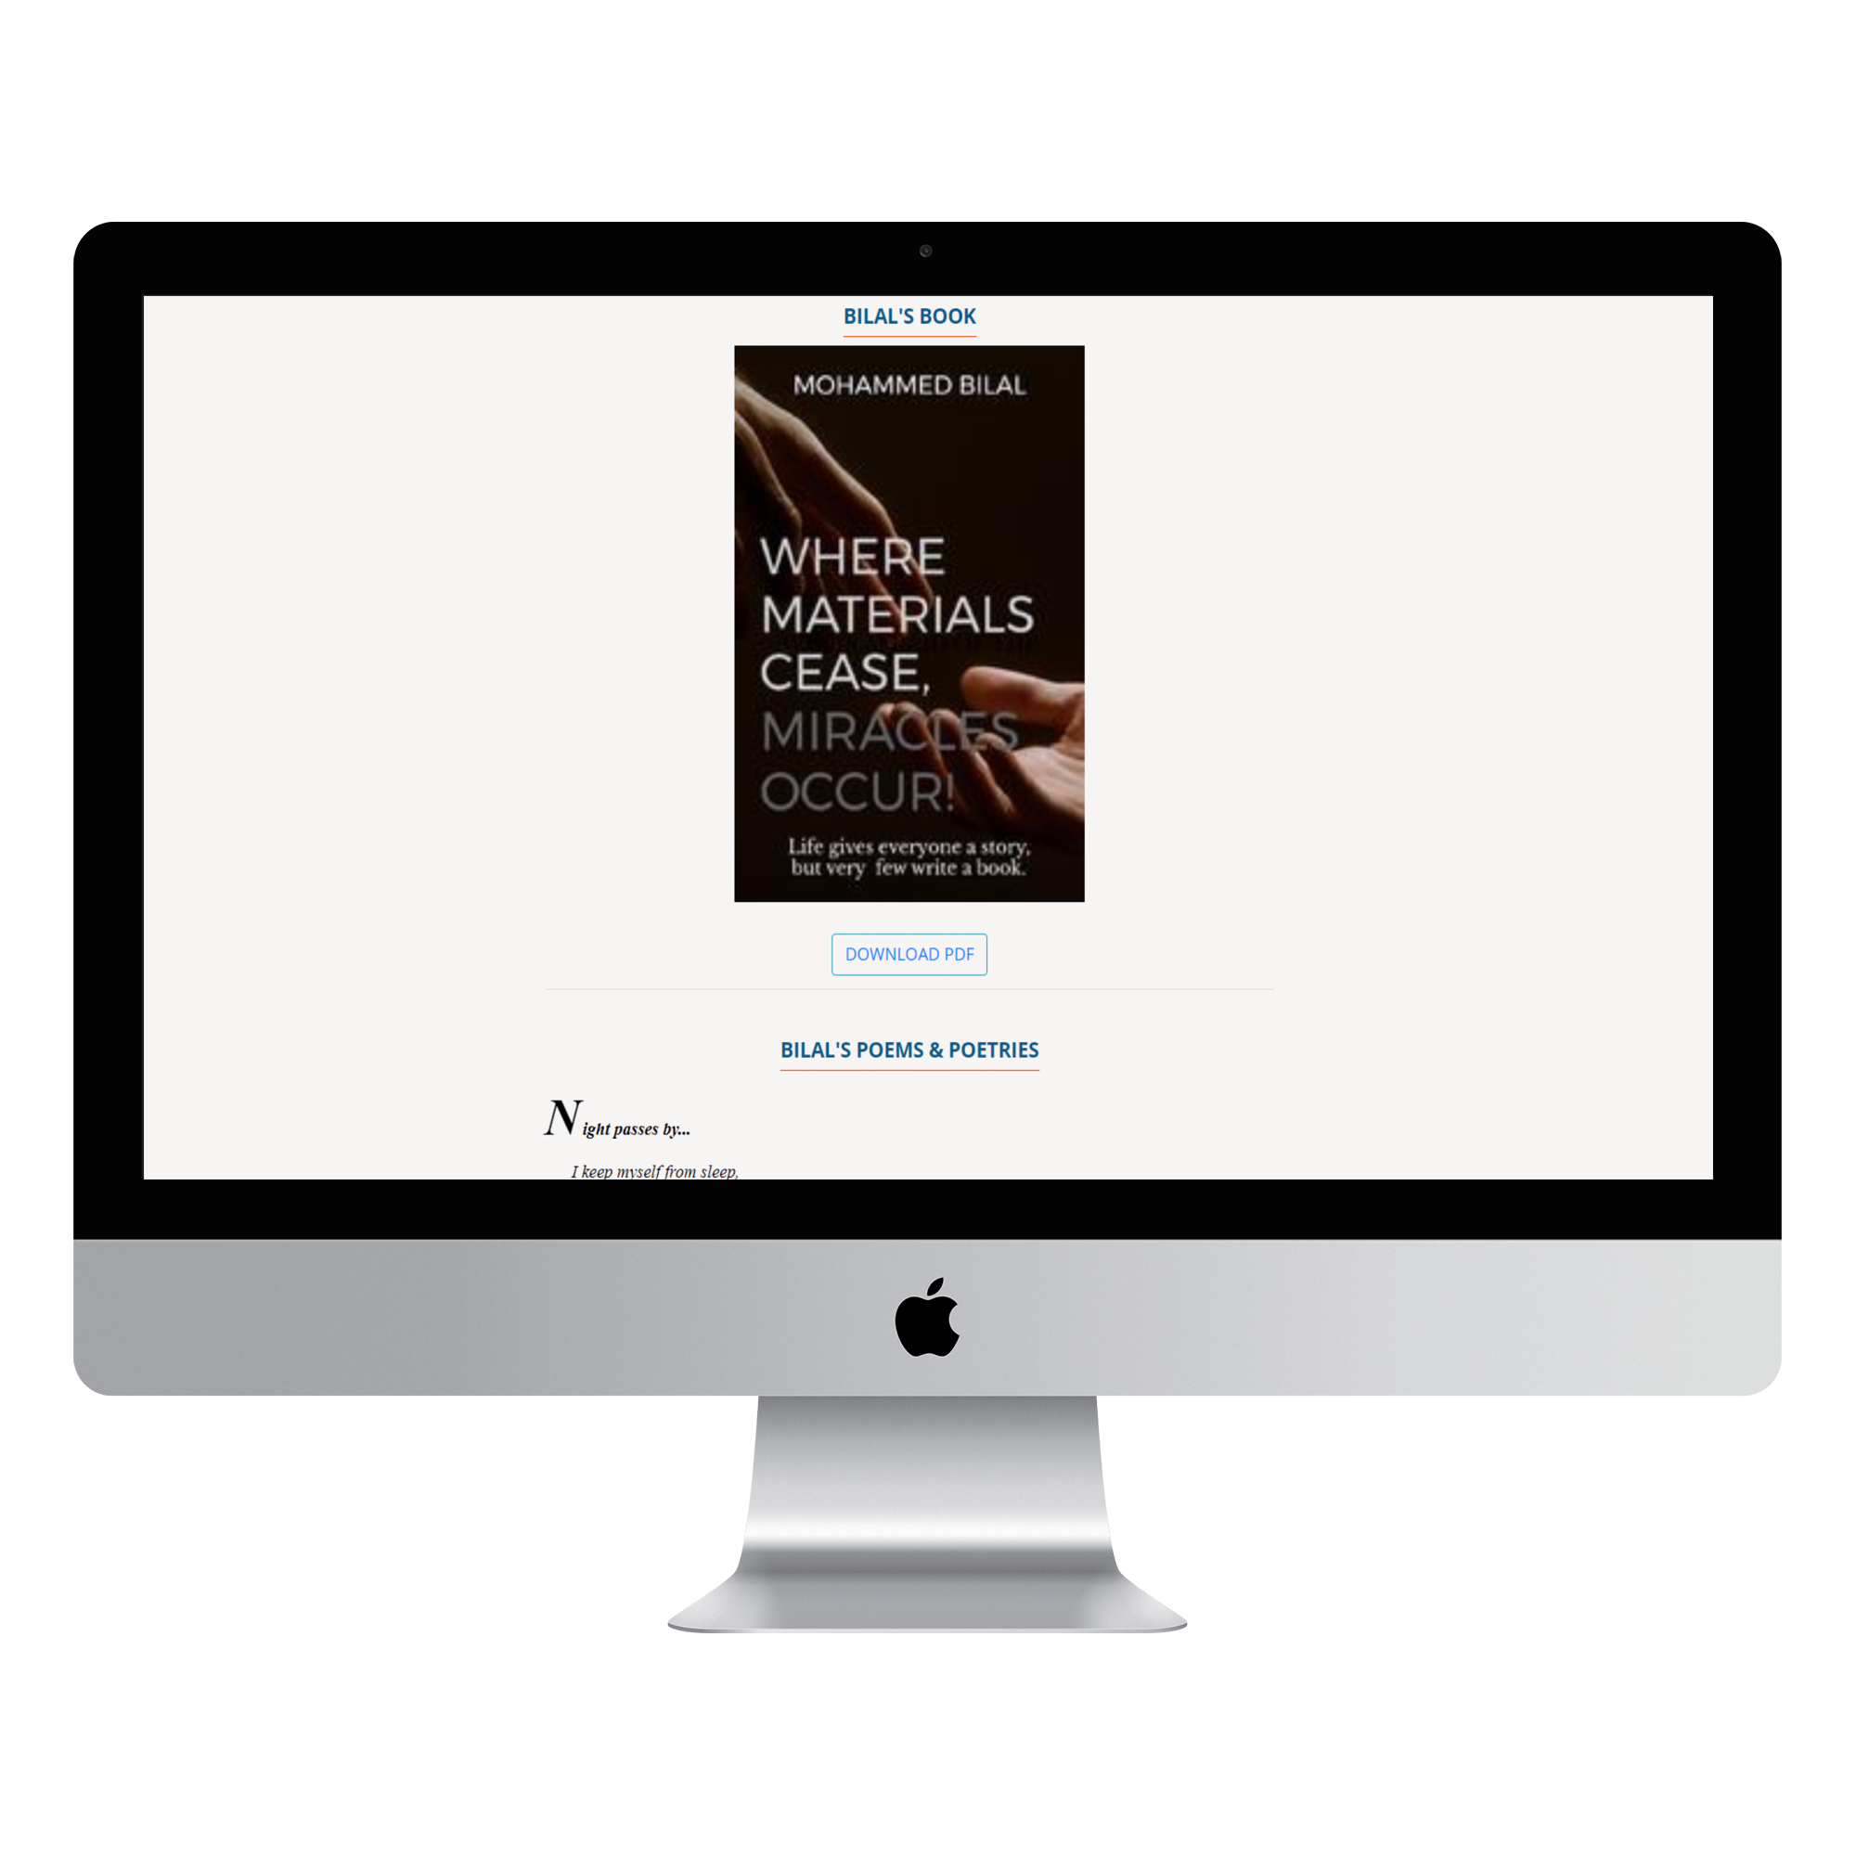
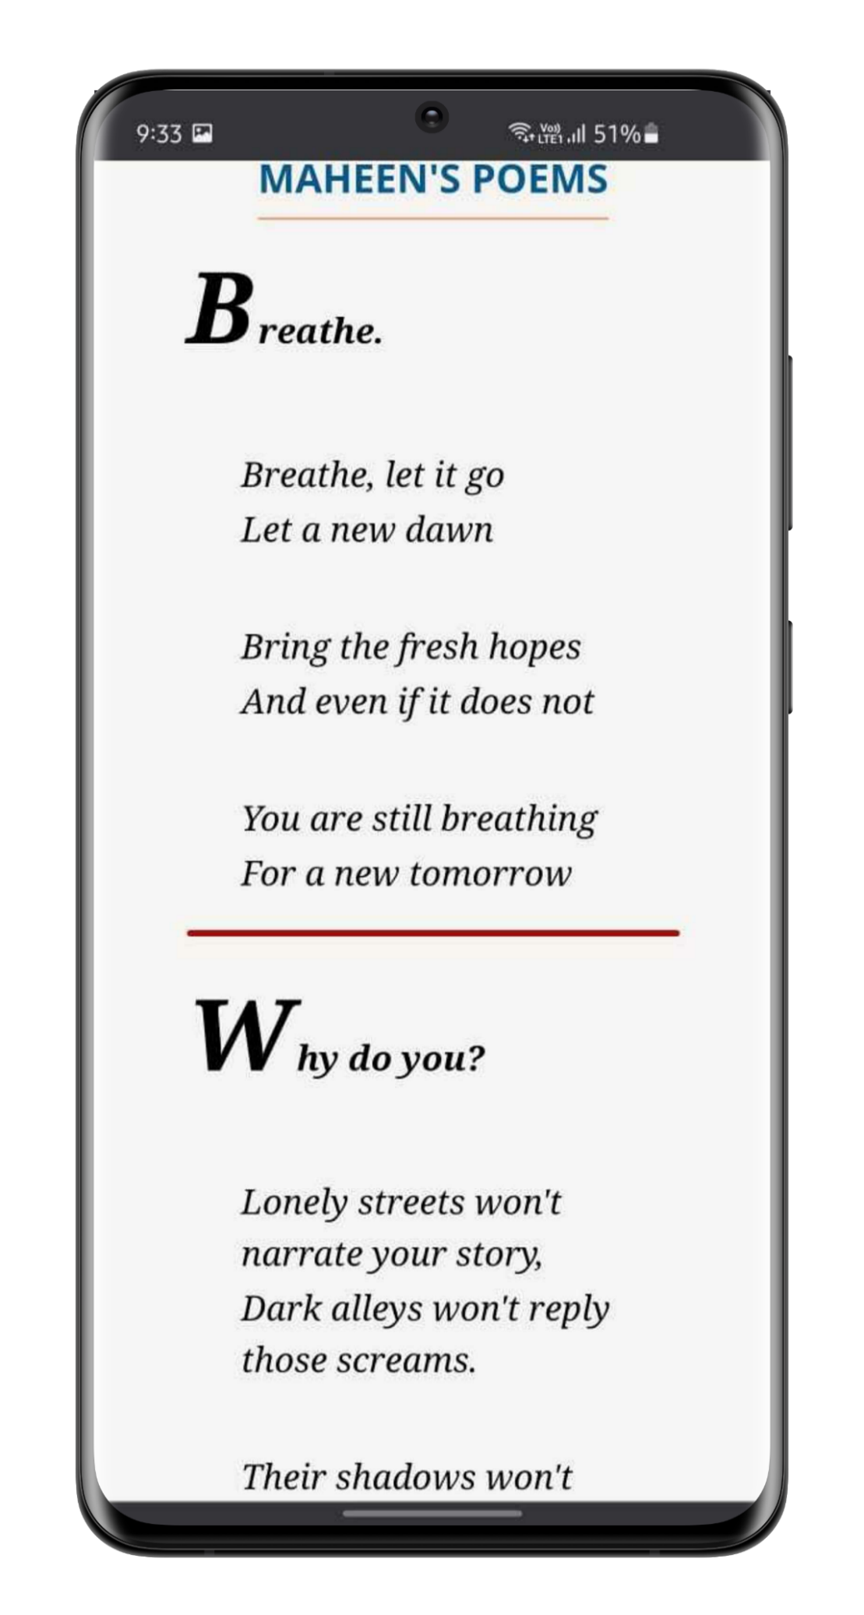
AUTHORS & POETS PAGE

Slide 11
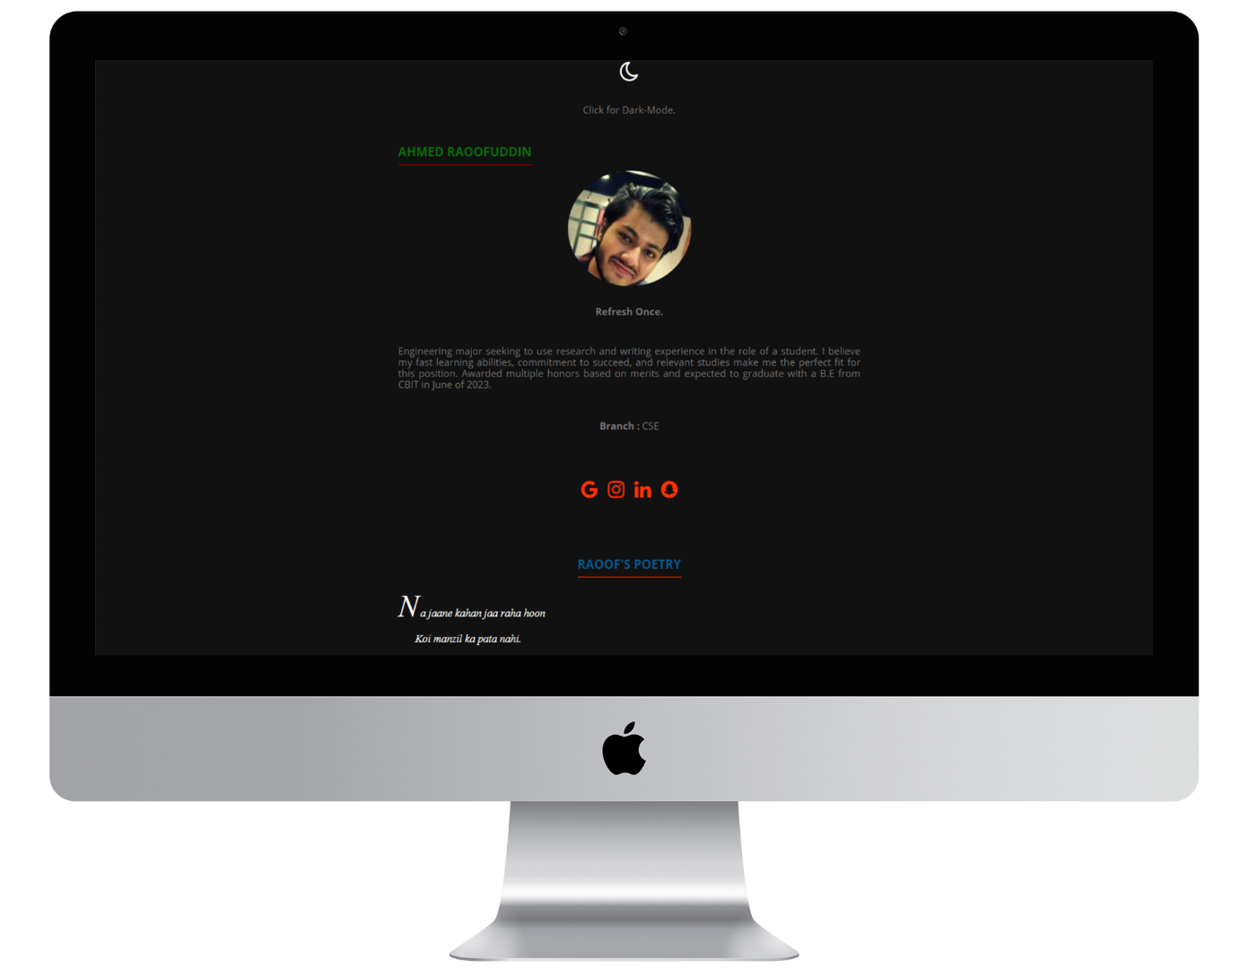
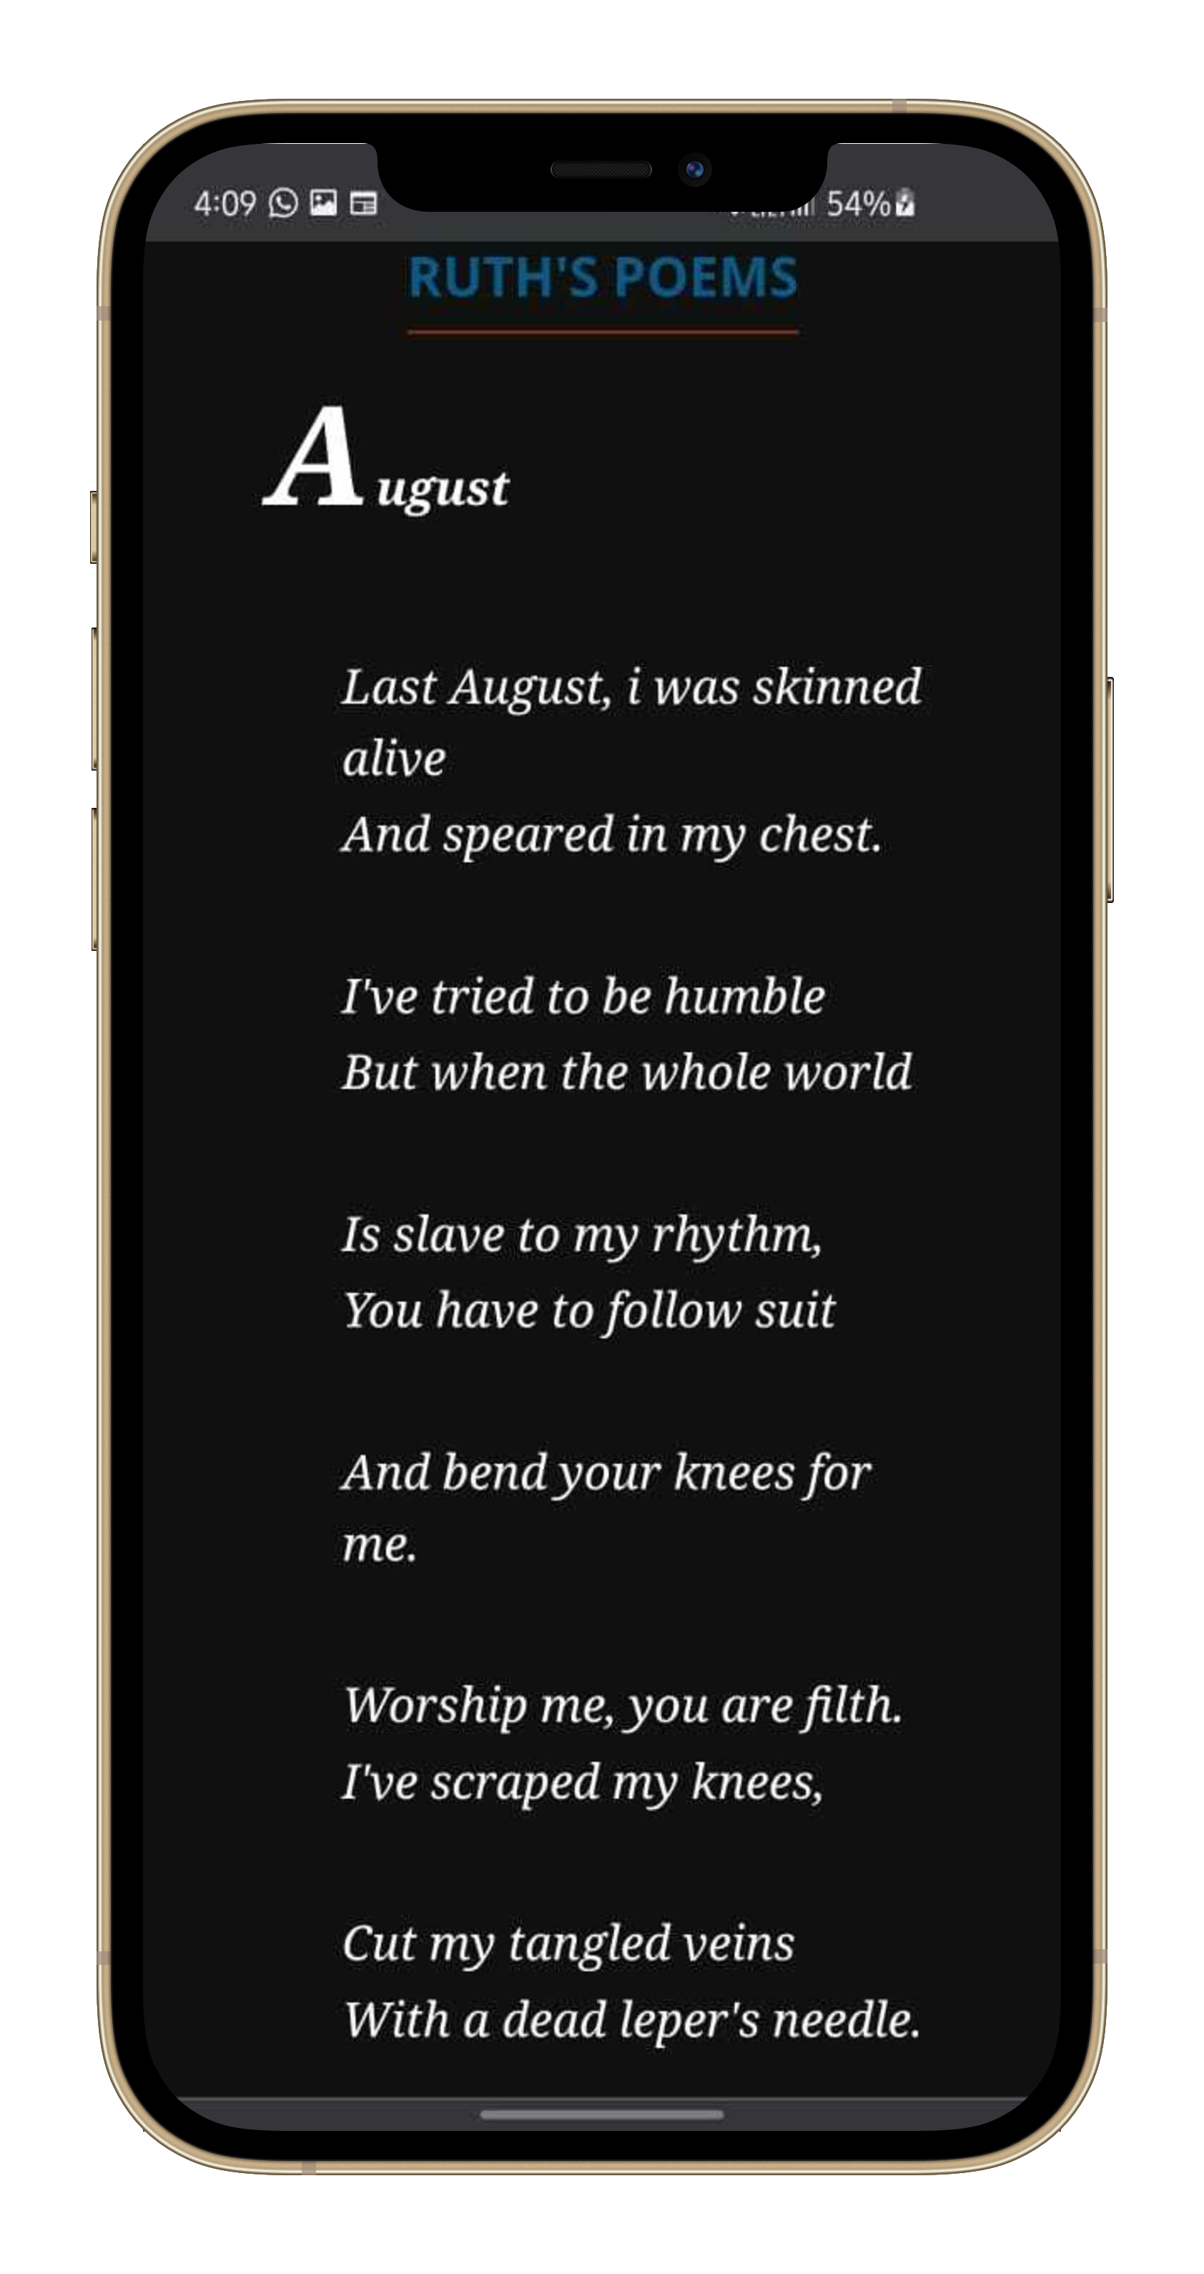
Includes Dark-Mode feature to enable the readers to view at comfort.
F
E
A
T
U
R
E
S

Slide 12
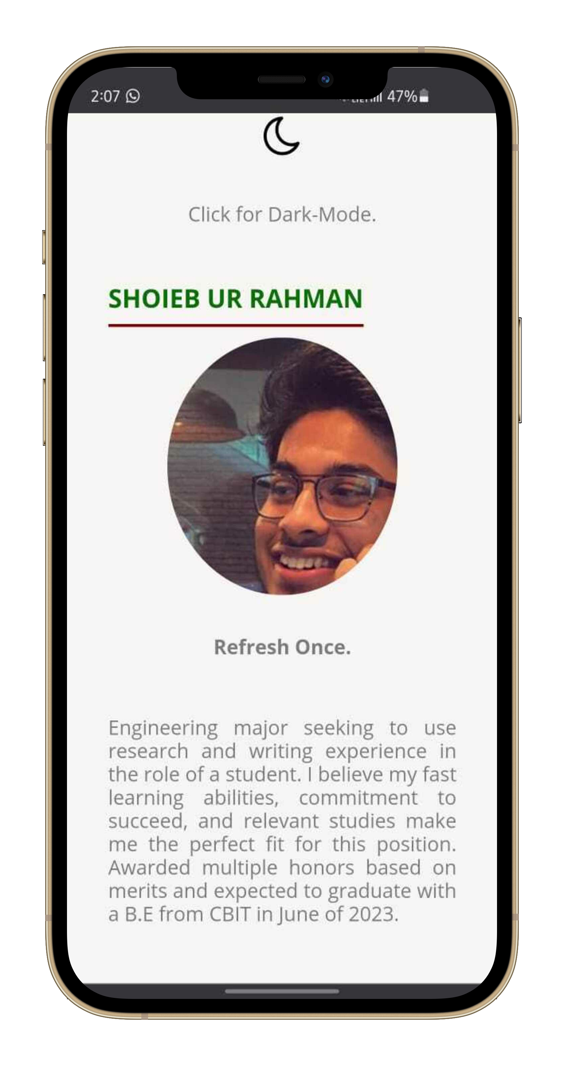
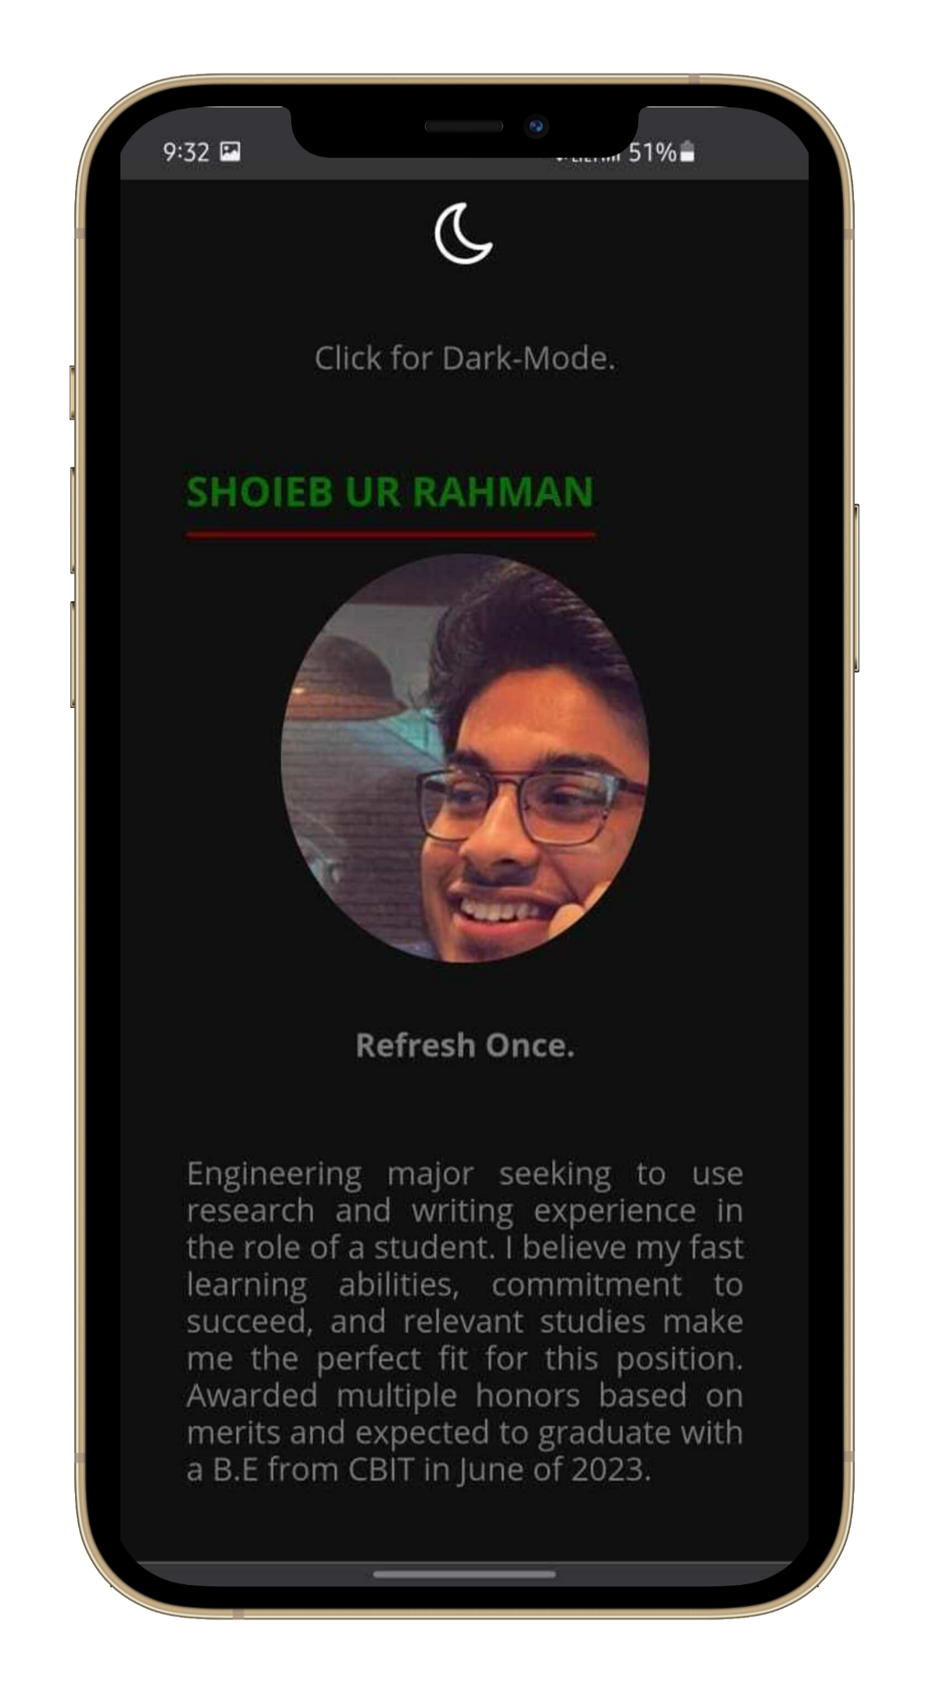
LIGHT
DARK

Slide 13
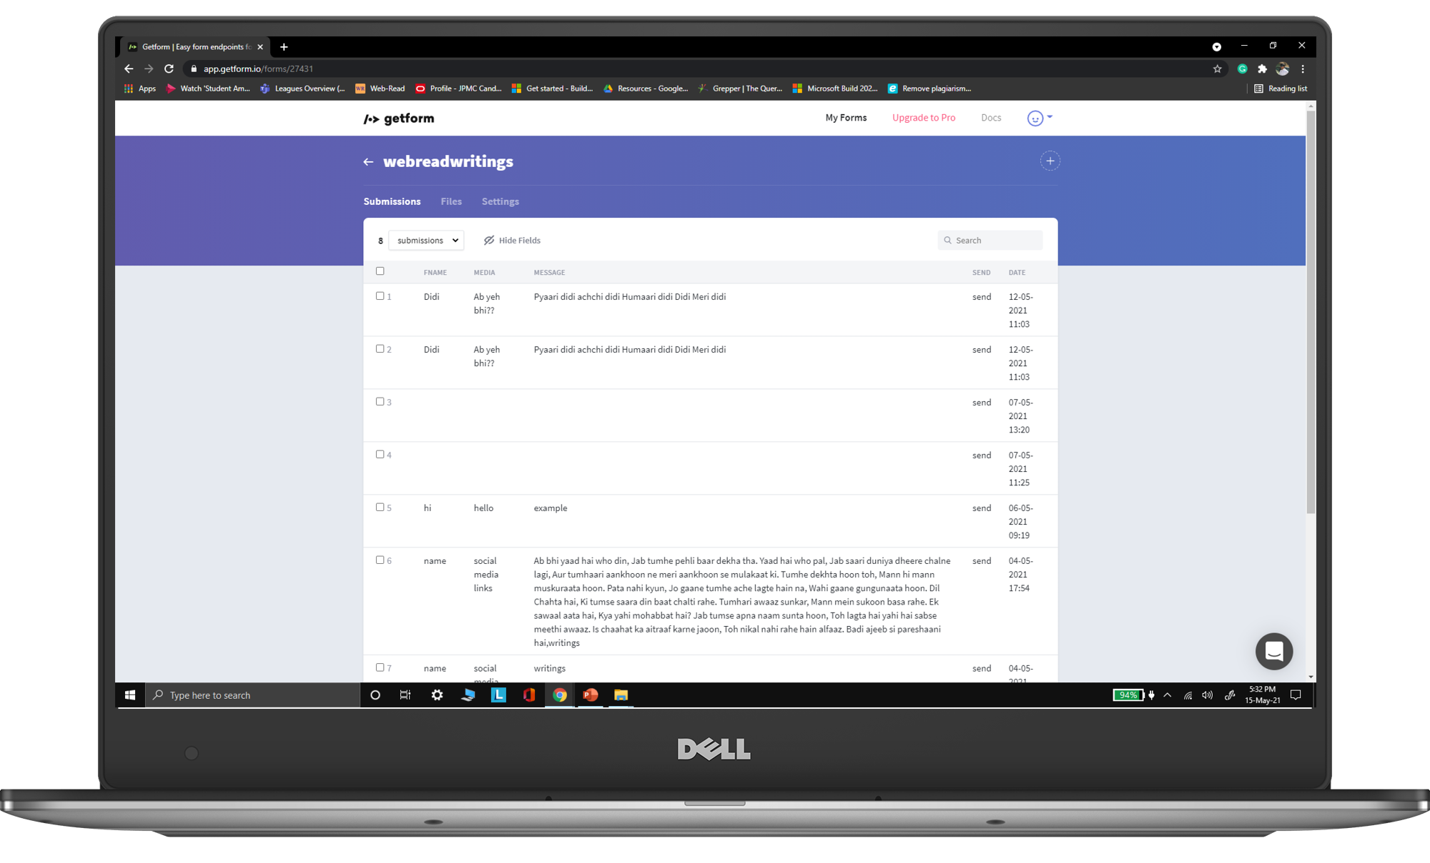
Getform.io
Comes with the support of sharing writings.

Slide 14

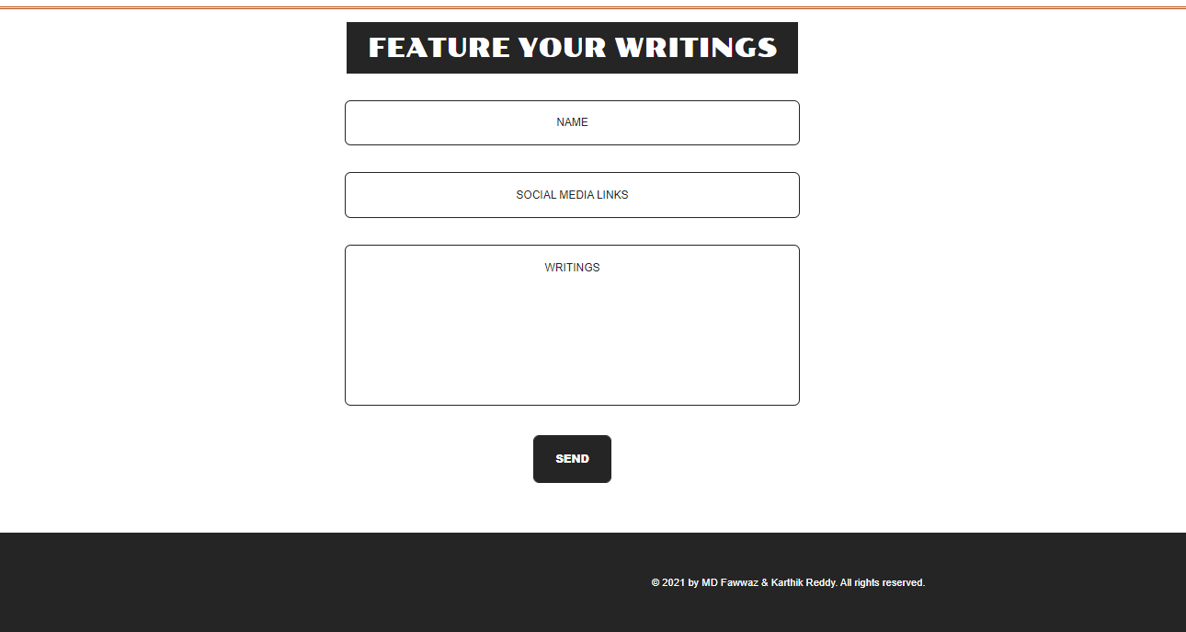
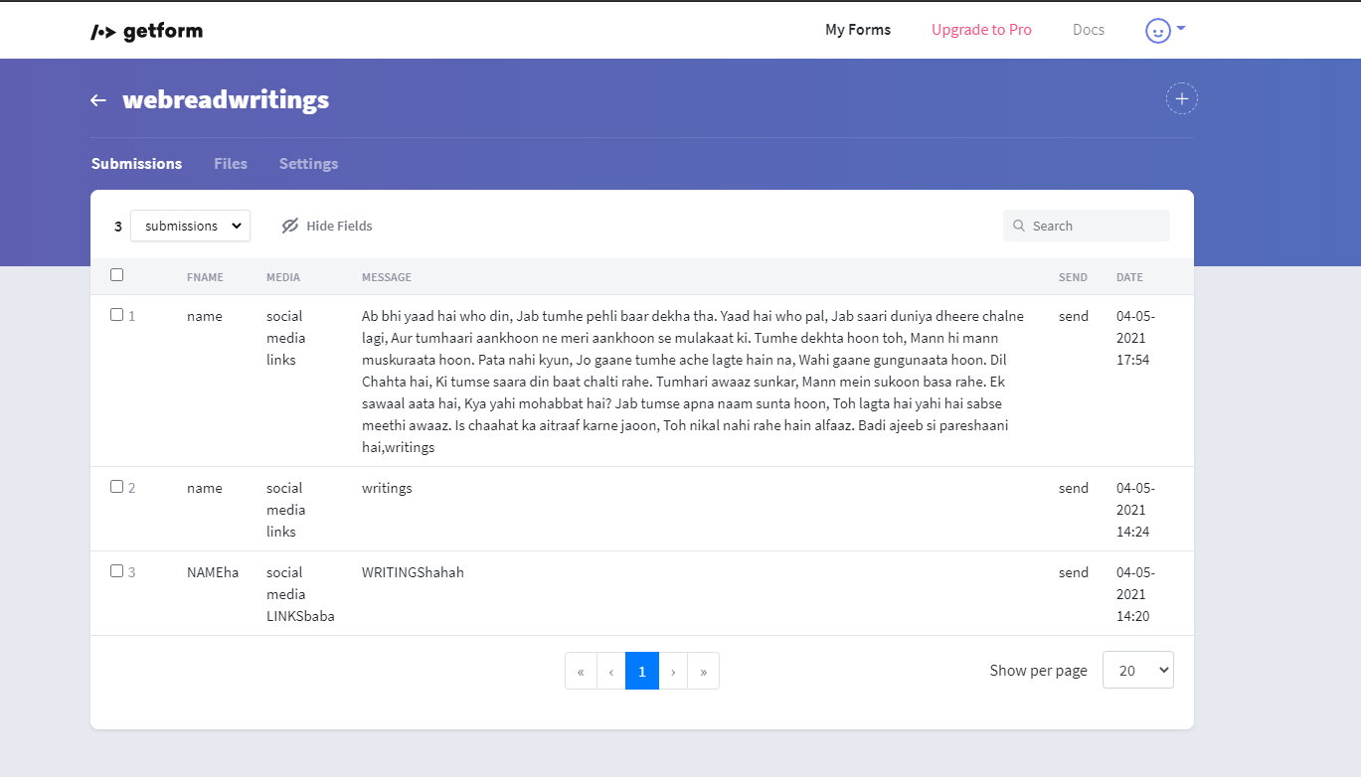
REVIEW. SORT. PUBLISH.

Slide 15
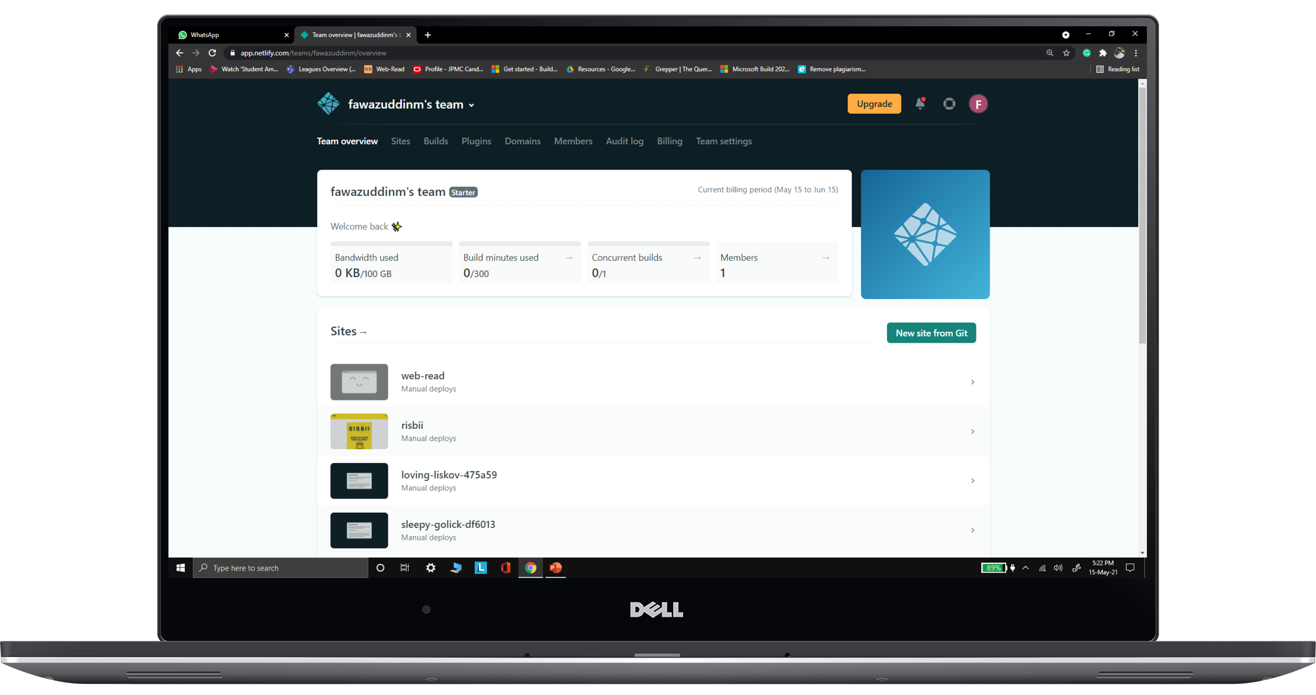
Netlify
Offers free hosting and serverless backend for websites.

Slide 16
FUTURE SCOPE
- Global Expansion.
- Additional Add-ons.

Slide 17
CONCLUSION
- A Platform to encourage the talent.
- Enormous access to reading enthusiasts.
- Collaborate. Ideate.

Slide 18


Thank You.
शुक्रिया
ధన్యవాదాలు

